Slide 1
DEMENTIA PREDICTIVE ANALYSIS
{ USING MRI SCANS }
By:
Hemang Monga PC 17
Ishaan Mandlik PC 29
Harshaan Arora PC 50
Kanishk Soman PC 51

Slide 2
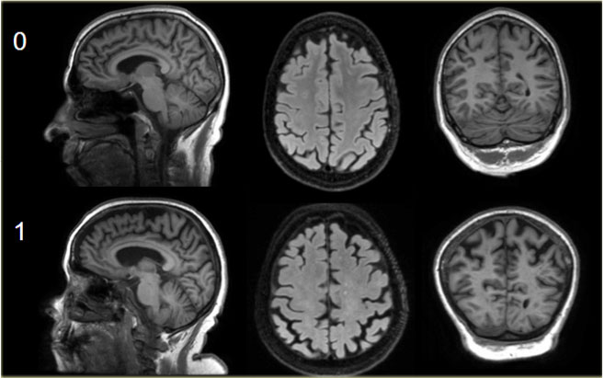
DATASET DESCRIPTION.
This set consists of a longitudinal collection of subjects aged 60 to 96. The subjects are all right-handed and include both men and women. 72 of the subjects were characterized as nondemented throughout the study. 64 of the included subjects were characterized as demented at the time of their initial visits and remained so for subsequent scans, including 51 individuals with mild to moderate Alzheimer’s disease. Another 14 subjects were characterized as nondemented at the time of their initial visit and were subsequently characterized as demented at a later visit.

Slide 3
ATTRIBUTES OF DATASET.
SES : Social Economic Status.
MMSE : Mini Mental State Examination.
AGE : 60 - 96 y/o
CDR : Clinical Dementia Rating.
ASF : Atlas Scaling Factor.
eTIV : Estimated Total Intra-Cranial Volume.
nWBV : Normalised Whole Brain Volume.
Gender : M / F
Education : Number Of Years of Study.
Hand : R / L
Visit : Number of Visits to the Doctor.
MR Delay : Delay b/w visits.

Slide 4
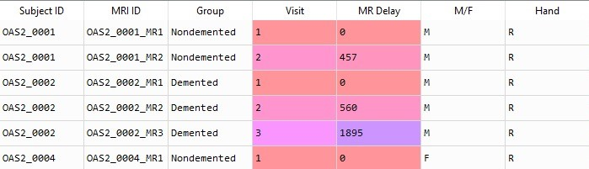
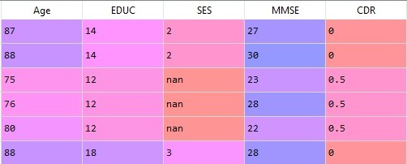
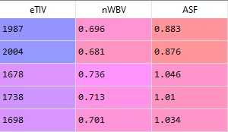

Slide 5
DATA CLEANING & PRE-PROCESSING.
DATA REDUCTION : DROPPED COLUMNS
LOGICAL REASONS
STATISTICAL SIGNIFICANCE
import pandas as pd
import numpy as np
import seaborn as sns
oasis_long = pd.read_csv('oasis_longitudinal.csv')
oasis_long = oasis_long.drop(columns = ['Hand', 'MRI ID', 'MR Delay', 'Subject ID', 'Visit'])

Slide 6
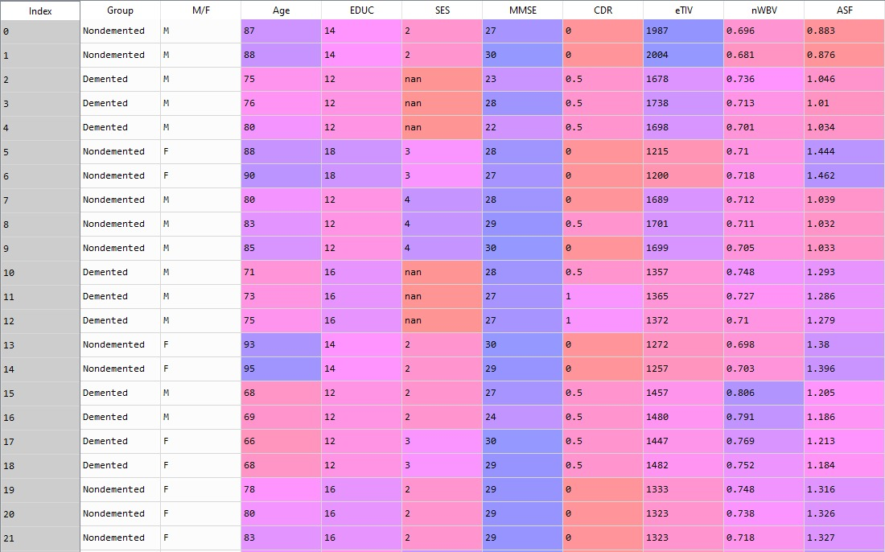

Slide 7
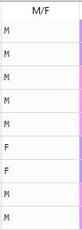
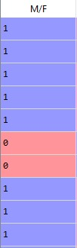
LABEL ENCODING :
ONE HOT ENCODER
.ASTYPE()
GENERAL LABEL ENCODING
y = oasis_long['Group'].astype('category')
X = oasis_long.iloc[:, 1:]
X1 = X
from sklearn.preprocessing import LabelEncoder
le = LabelEncoder()
X.iloc[:, 0] = le.fit_transform(X.iloc[:, 0])

Slide 8
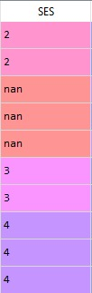
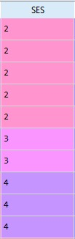
HANDLING MISSING VALUES : NaN VALUES
from sklearn.impute import SimpleImputer
imputer_SES = SimpleImputer(missing_values=np.nan, strategy='median')
imputer_MMSE = SimpleImputer(missing_values=np.nan, strategy='mean')
X.iloc[:, 3:4] = imputer_SES.fit_transform(X.iloc[:, 3:4])
X.iloc[:, 4:5] = imputer_MMSE.fit_transform(X.iloc[:, 4:5])

Slide 9
DATA TRANSFORMATION : STANDARD SCALER
Z-SCORE
from sklearn.preprocessing import StandardScaler
sc = StandardScaler()
X = sc.fit_transform(X)
from sklearn.model_selection import train_test_split
X_train, X_test, y_train, y_test = train_test_split(X, y, test_size = 0.25, random_state = 0)

Slide 10
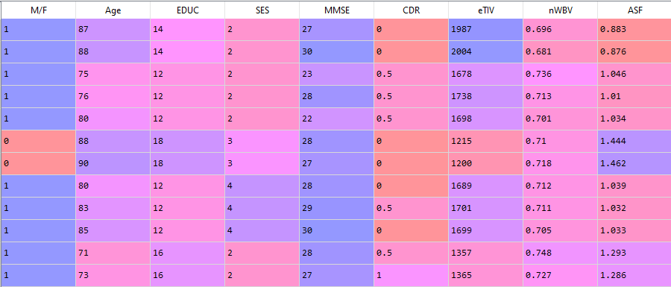

Slide 11
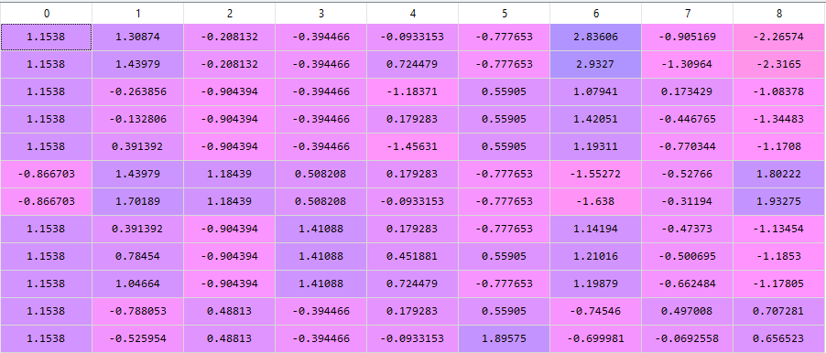
Z-SCORE IMPLEMENTATION.

Slide 12
MODEL SELECTION :
models_list = []
models_list.append(('LOG', LogisticRegression()))
models_list.append(('RFC', RandomForestClassifier()))
models_list.append(('SVM', SVC(gamma = 'scale')))
models_list.append(('NB', GaussianNB()))
models_list.append(('KNN', KNeighborsClassifier()))
from sklearn.ensemble import RandomForestClassifier
from sklearn.neighbors import KNeighborsClassifier
from sklearn.linear_model import LogisticRegression
from sklearn.naive_bayes import GaussianNB
from sklearn.svm import SVC
from sklearn.model_selection import cross_val_score
results = []
names = []
for name, model in models_list:
cv_results = cross_val_score(estimator = model, X = X_train, y = y_train, cv=10,scoring='accuracy', n_jobs = -1)
results.append(cv_results)
names.append(name)
print( "%s: %f " % (name, cv_results.mean()))

Slide 13
RAINFOREST ALGORITHM
ACCURACY :
LOG: 0.896392
RFC: 0.914126
SVM: 0.899840
NB: 0.907115
KNN: 0.874954
from sklearn.ensemble import RandomForestClassifier
#rf = RandomForestClassifier()
rf = RandomForestClassifier(n_estimators = 15, criterion = 'entropy', bootstrap= True,max_features = ‘sqrt’)
rf.fit(X_train, y_train)
y_pred = rf.predict(X_test)
from sklearn.model_selection import GridSearchCV
parameters = [{'n_estimators' : [1, 5, 10, 15, 20], 'criterion' : ['gini', 'entropy'],
'max_features' :['auto', 'sqrt'], 'bootstrap' : [True, False]}]
grid = GridSearchCV(estimator= rf, param_grid = parameters,
scoring = 'accuracy',
cv = 10, n_jobs=-1)
grid.fit(X_train, y_train)
best_accuracy = grid.best_score_
best_paramenters = grid.best_params_

Slide 14
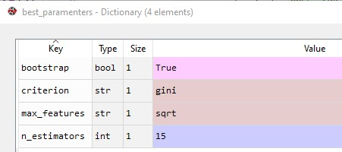
OUTPUT : 93.1% BEST ACCURACY

Slide 15
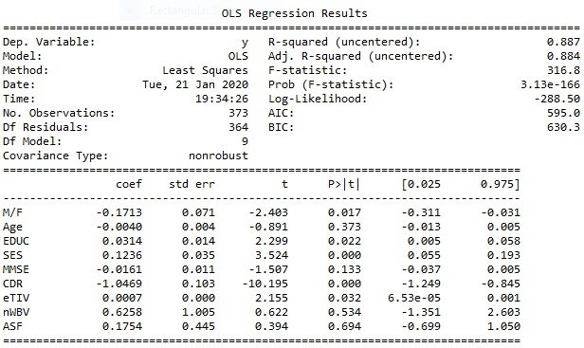
STATISTICAL SUMMARY.
import statsmodels.api as sm
y1 = le.fit_transform(y)
from sklearn.preprocessing import OneHotEncoder
ohe = OneHotEncoder(categories = [0])
y1 = ohe.fit_transform(y1)
regressor_OLS = sm.OLS(y1, X1).fit()
regressor_OLS.summary()

Slide 16
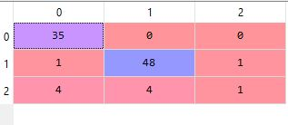
CONFUSION MATRIX.
from sklearn.metrics import confusion_matrix, accuracy_score, classification_report
cm = confusion_matrix(y_test, y_pred, labels=['Demented', 'Nondemented', 'Converted'])
acc = accuracy_score(y_test, y_pred)
print(classification_report(y_test, y_pred))

Slide 17
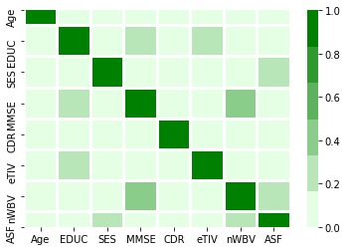
DATA VISUALIZATION.
CORRELATION ANALYSIS
corr = oasis_long.corr()
sns.heatmap(corr, vmin = 0, vmax = 1, cmap=sns.light_palette("green"), linewidths = 2)

Slide 18
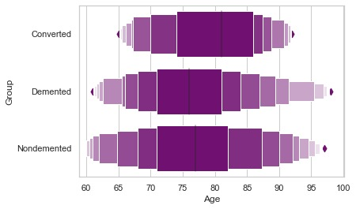
DATA VISUALIZATION.
sns.set(style="whitegrid")
sns.boxenplot(x= X1.iloc[:, 5], y = X1.iloc[:, 3],
color="b", scale='linear')
sns.boxenplot(x= X1['SES'], y=y,
color="green", scale='linear')
sns.boxenplot(x= X1['CDR'], y=y,
color="b", scale='linear')
sns.boxenplot(x= X1['EDUC'], y=y,
color="green", scale='linear')
sns.boxenplot(x= X1['Age'], y=y,
color="red", scale='linear')
sns.boxenplot(x= X1['eTIV'], y=y,
color="grey", scale='linear')
AGE v/s GROUP

Slide 19
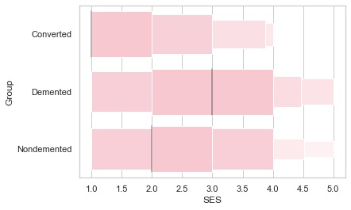
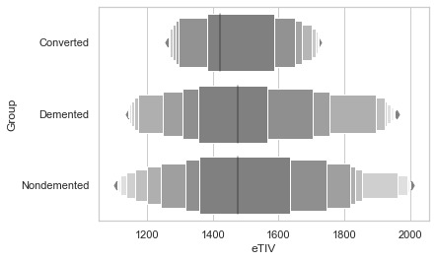
eTIV v/s GROUP
SES v/s GROUP

Slide 20
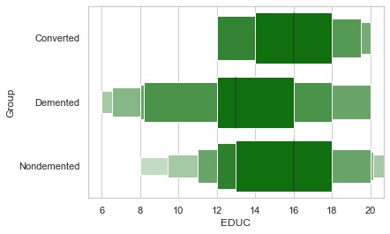
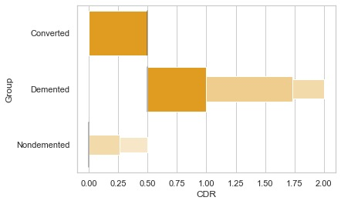
CDR v/s GROUP
EDUC v/s GROUP

Slide 21
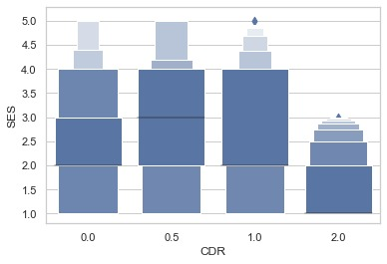
SES v/s CDR

Slide 22
THANK
YOU

